Slide 2
FRANKFINN PLACEMENTS FROM AGRA COLLEGE
STUDENTS
IN 2025

Slide 3
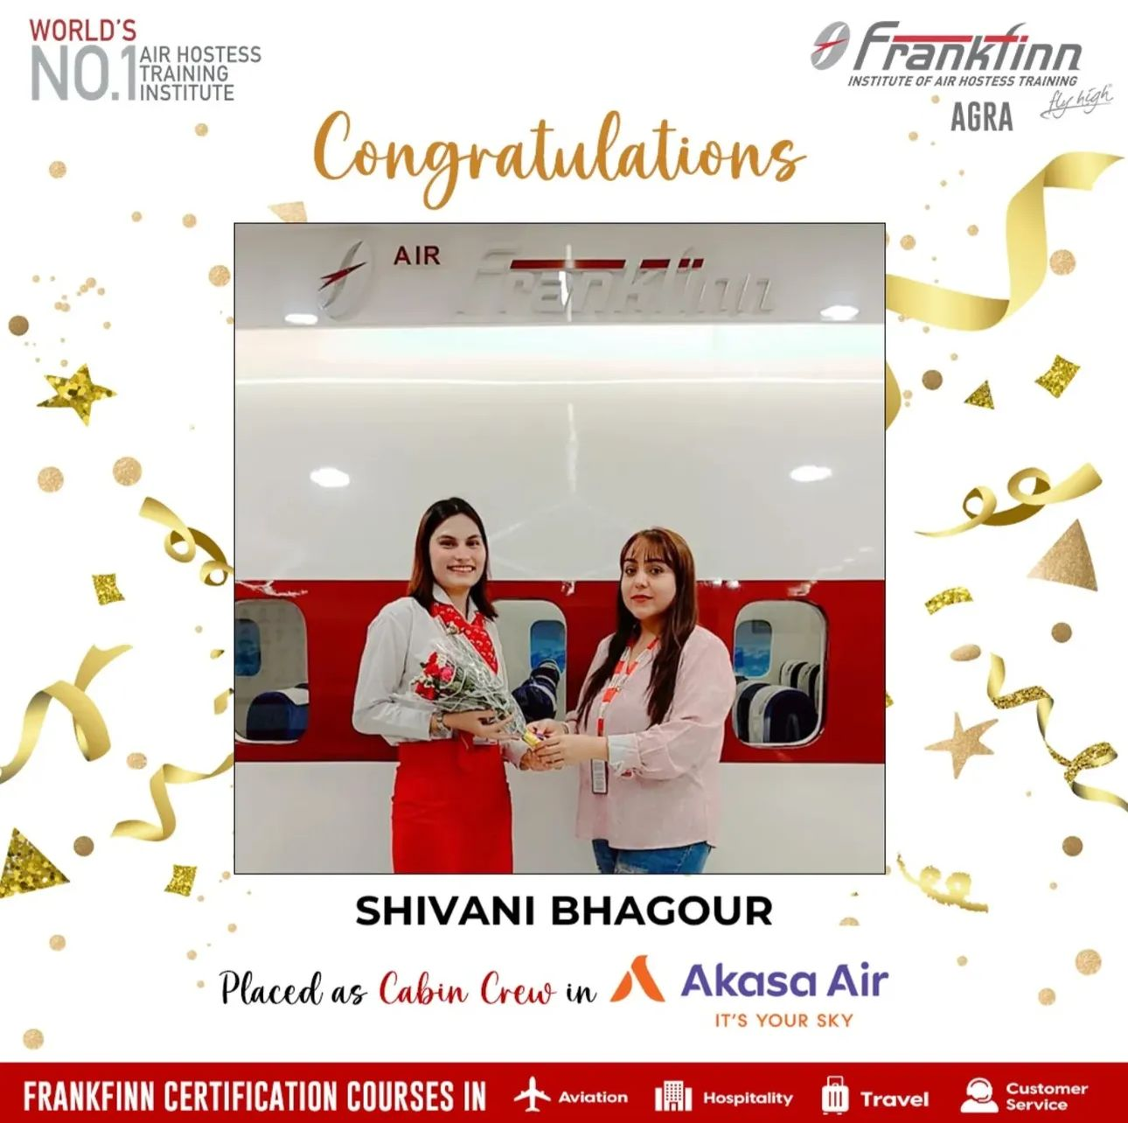

SHIVANI BHAGOUR
PLACED AS CABIN CREW IN AKASA AIRLINE
B.SC PASS OUT IN AGRA COLLEGE 2021

Slide 4
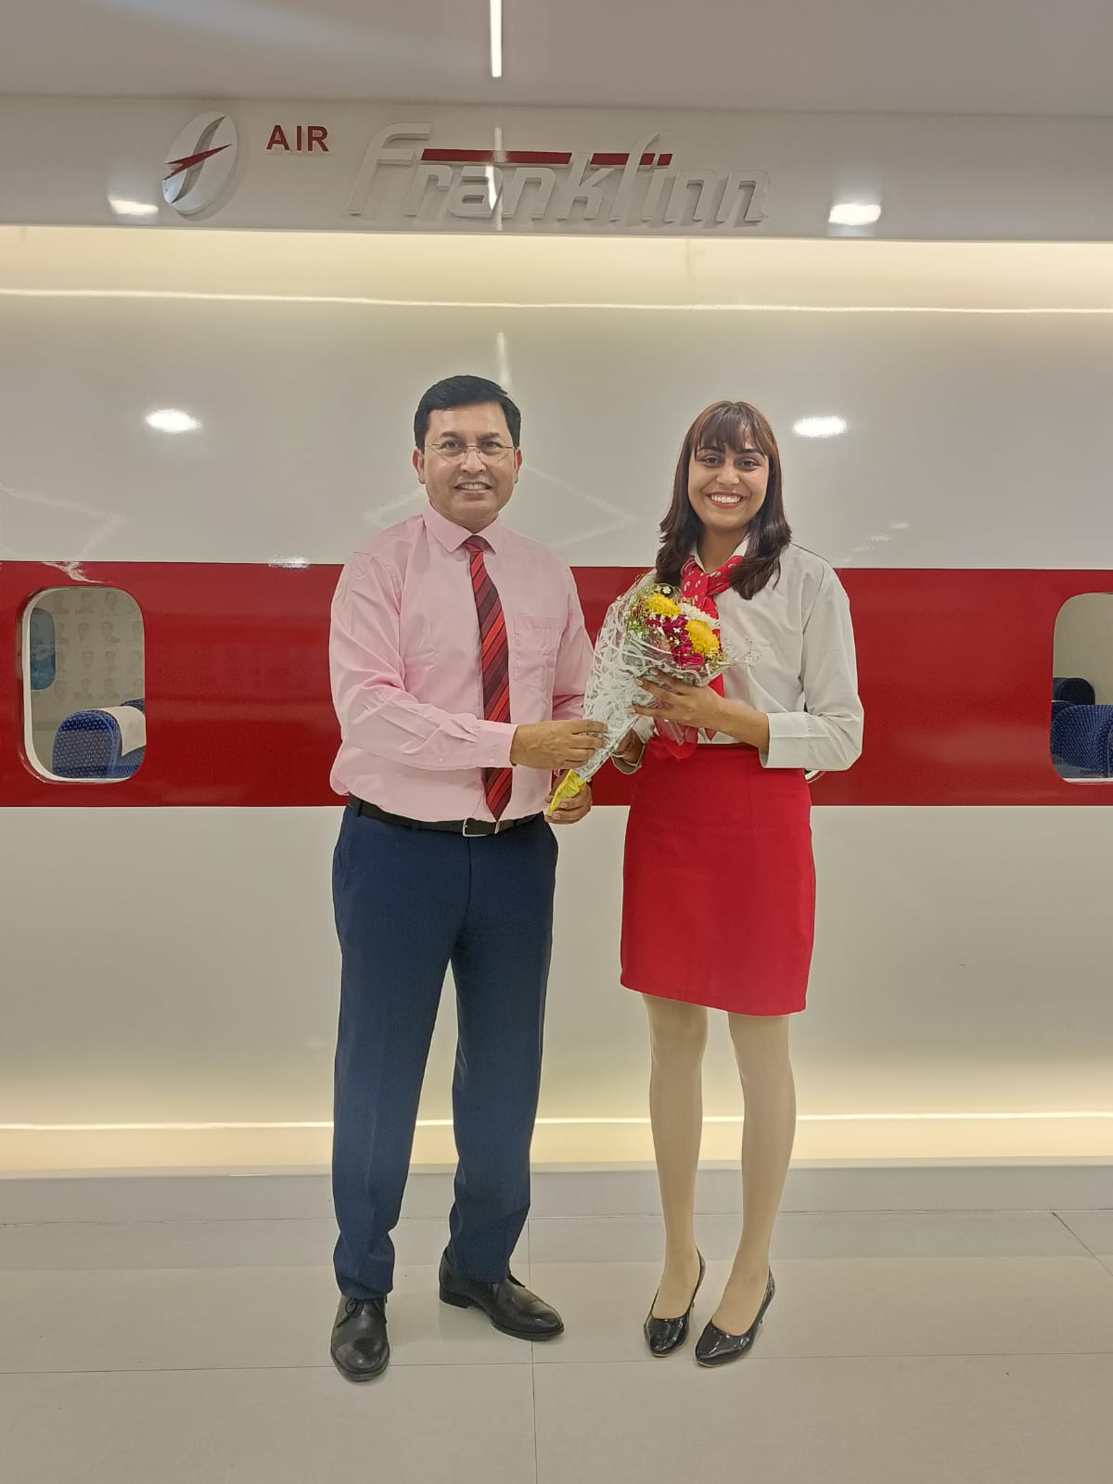

SALONI BHAGOUR
PLACED AS CABIN CREW IN AIR INDIA AIRLINE
B.A. PASS OUT IN AGRA COLLEGE 2024

Slide 5
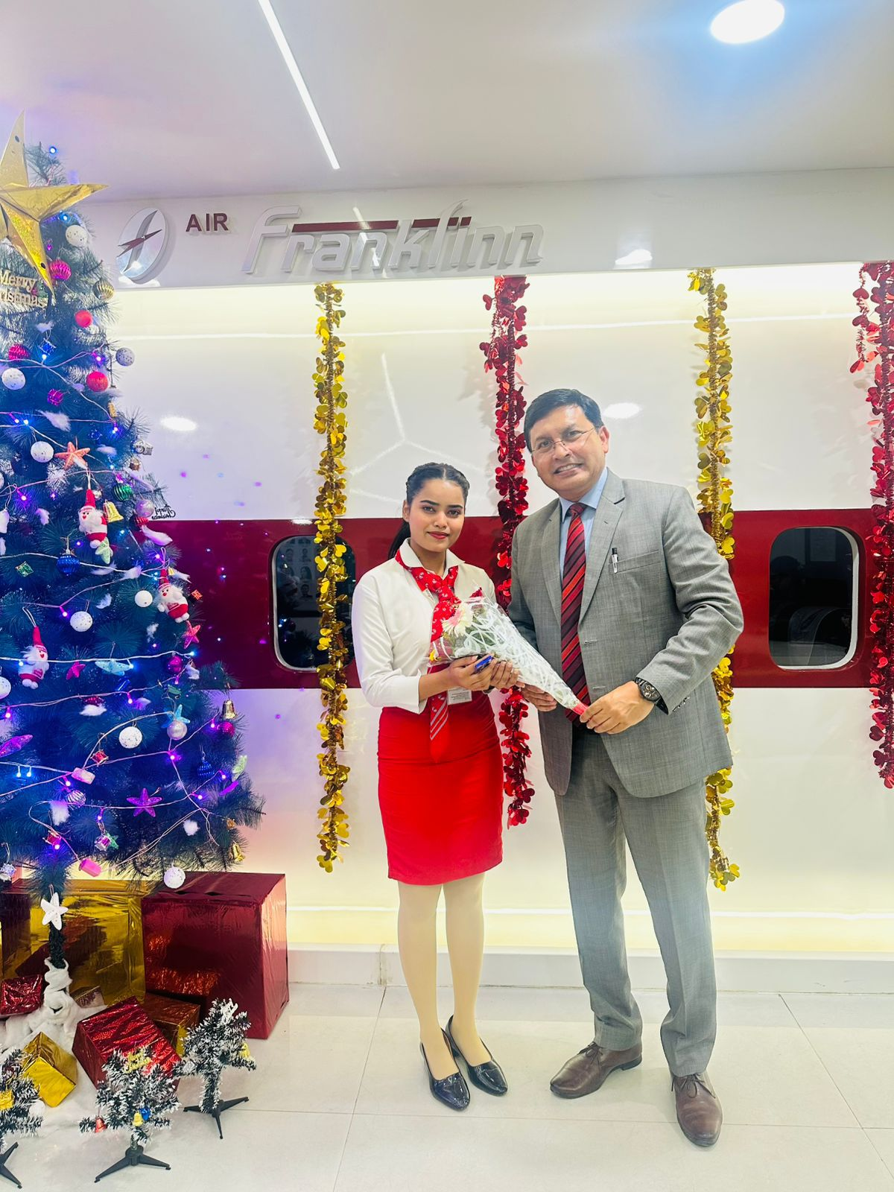

PRIYANSHI SHAKYA
PLACED IN STERLING HOTEL
B.SC PASS OUT IN AGRA COLLEGE 2025

Slide 6
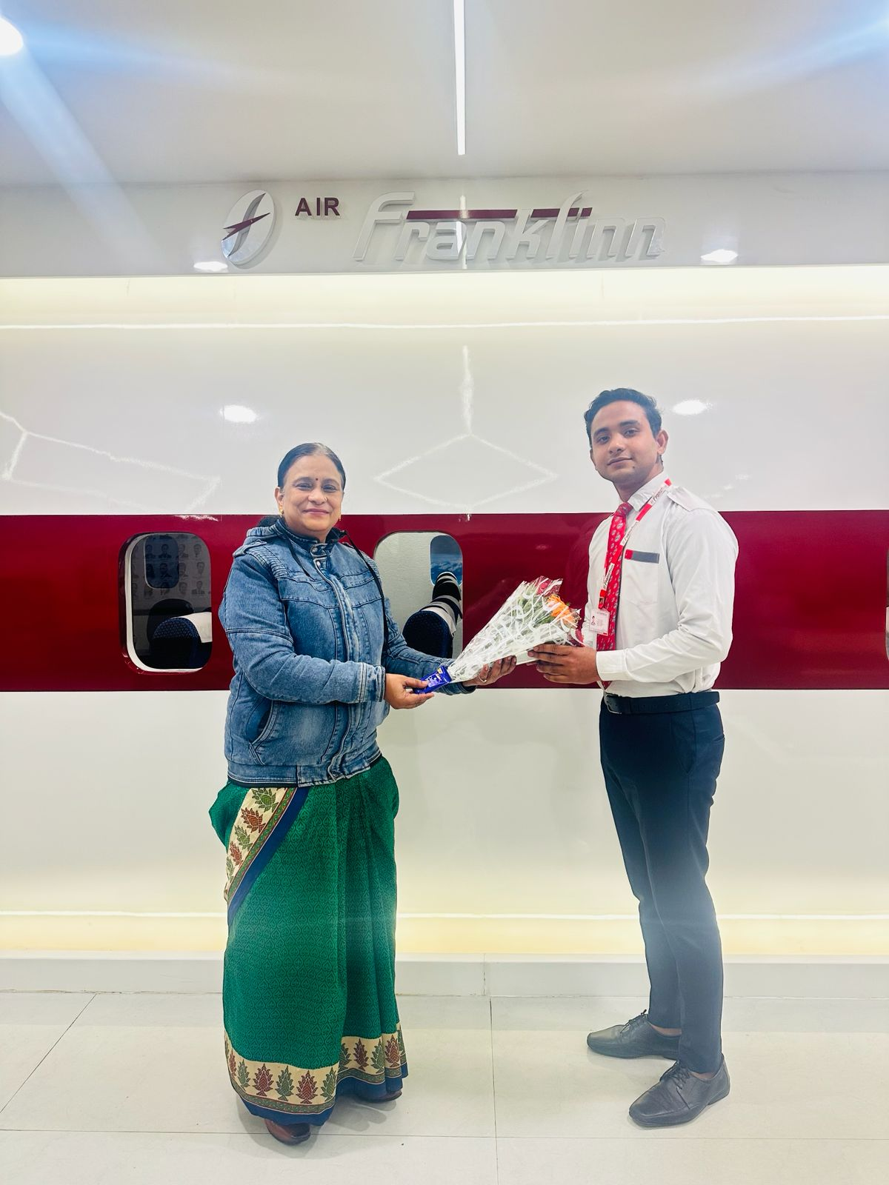

ABHIJEET GOUD
PLACED IN
BLOOM HOTELS
B.A. PASS OUT IN AGRA COLLEGE 2024-26

Slide 7
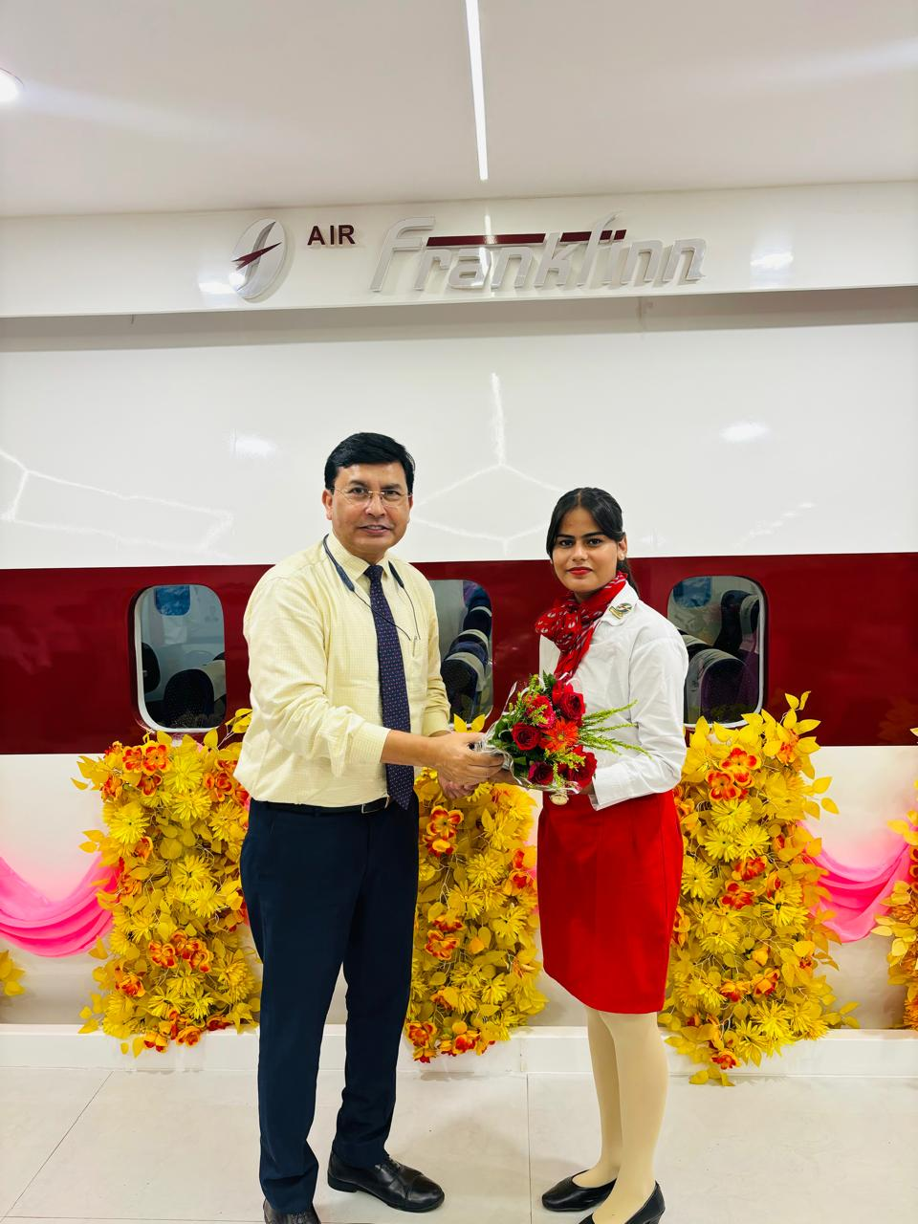

LOUNGE
B.1. PASS OUT IN AGRA COLLEGE 2023
SONU ARUN

Slide 8


LOUNGE
B.SC PASS OUT IN AGRA COLLEGE 2023
SHAIN KHAN

Slide 9

B.SC PASS OUT IN AGRA COLLEGE 2025
ROSHNI SONKER
LOUNGE

Slide 10
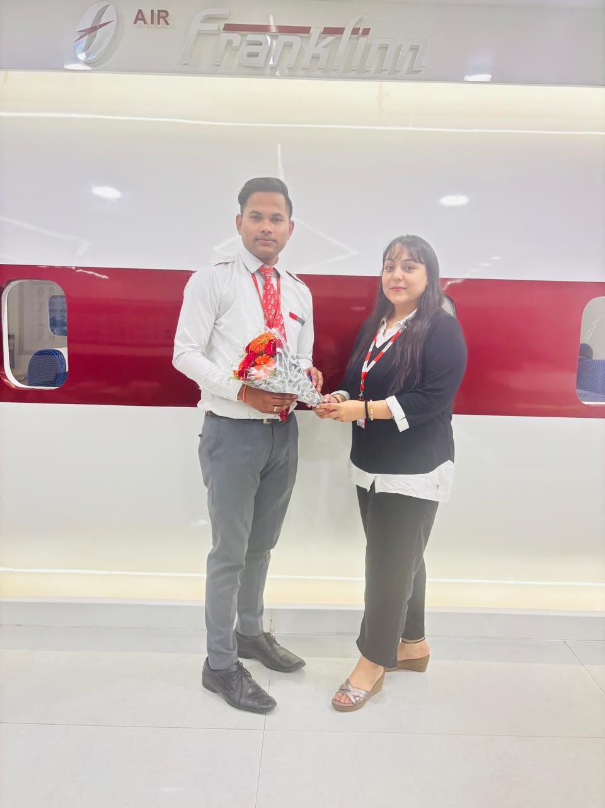
LOUNGE
B.SC PASS OUT IN AGRA COLLEGE 2023
ROHAN
KUMAR

Slide 11

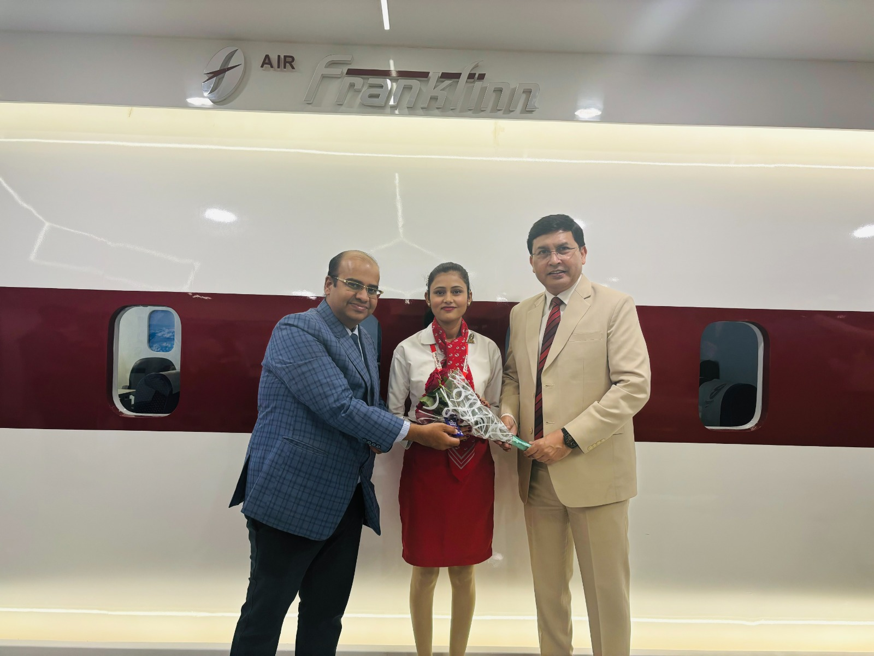
RAVEENA
B.A. PASS OUT IN AGRA COLLEGE 2023

Slide 12
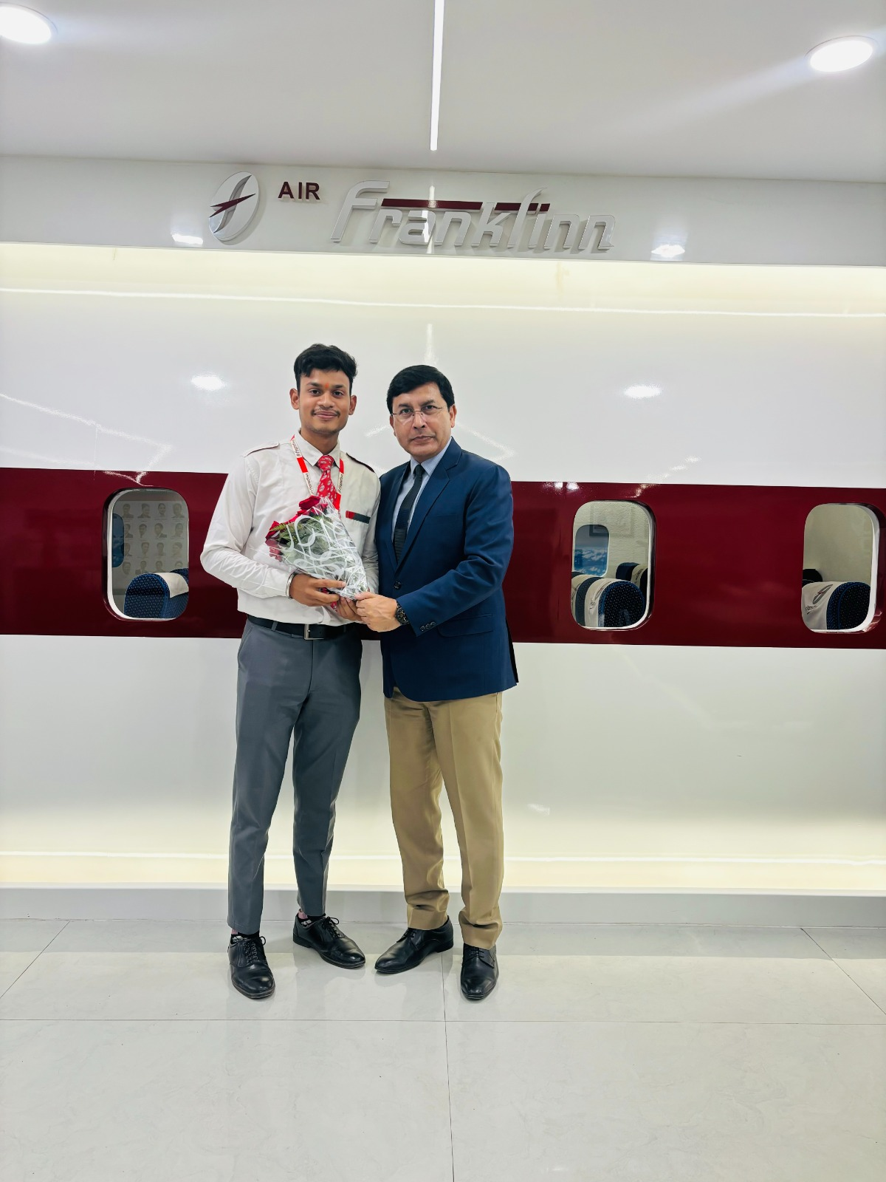
OM SONI
B.SC PASS OUT IN AGRA COLLEGE 2023

Slide 13


